Slide 1
vi editor
Pronounced: `vee eye‘’

Slide 2
Agenda
Describe the background of vi Editor
Use vi editor to:
  create text files
  edit text files
Our Goal is to create and run a shell scripts

Slide 3
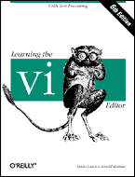
Suggested Reading
Chapter 3
Class Handouts
Or if your really need to know about vi try “Learning the vi Editor, 6th Edition” from Oreilly.Com

Slide 4
What is vi ?
The visual editor on the Unix.
Before vi the primary editor used on Unix was the line editor
  User was able to see/edit only one line of the text at a time
The vi editor is not a text formatter (like MS Word, Word Perfect, etc.)
  you cannot set margins
  center headings
  Etc…

Slide 5
Vi History
Although other stories exist, the true one tells that vi was originally written by Bill Joy in 1976.
Who is Bill Joy you ask?
  He co-founded Sun Microsystems in 1982 and served as chief scientist until 2003.
Joy's prowess as a computer programmer is legendary, with an oft-told anecdote that he wrote the vi editor in a weekend. Joy denies this assertion.

Slide 6
Some Vi Ports
All Unix OS’s
MS-Dos
Windows 3.x
Windows 9x/2k/NT/XP
OS/2
Macintosh
Atari
Amiga
OpenVMS/Alpha
OpenVMS/VAX

Slide 7
Characteristics of vi
The vi editor is:
  a very powerful
  but at the same time it is cryptic
  It is hard to learn, specially for windows users
The best way to learn vi commands is to use them
So Practice…

Slide 8

Vim equals Vi
The current iteration of vi for Linux is called vim
  Vi Improved
  http://www.vim.org

Slide 9
Starting vi
Type vi <filename> at the shell prompt
After pressing enter the command prompt disappears and you see tilde(~) characters on all the lines
These tilde characters indicate that the line is blank

Slide 10
Vi modes
There are two modes in vi
  Command mode
  Input mode
When you start vi by default it is in command mode
You enter the input mode through various commands
You exit the input mode by pressing the Esc key to get back to the command mode

Slide 11
How to exit from vi
First go to command mode
  press Esc There is no harm in pressing Esc even if you are in command mode. Your terminal will just beep and/or or flash if you press Esc in command mode
There are different ways to exit when you are in the command mode

Slide 12
How to exit from vi
(comand mode)
:q <enter> is to exit, if you have not made any changes to the file
:q! <enter> is the forced quit, it will discard the changes and quit
:wq <enter> is for save and Exit
:x <enter> is same as above command
ZZ is for save and Exit (Note this command is uppercase)
The ! Character forces over writes, etc. :wq!

Slide 13
Moving Around
You can move around only when you are in the command mode
Arrow keys usually works(but may not)
The standard keys for moving cursor are:
  h - for left
  l - for right
  j - for down
  k - for up

Slide 14
Moving Around
w - to move one word forward
b - to move one word backward
$ - takes you to the end of line
<enter> takes the cursor the the beginning of next line

Slide 15
Moving Around
- - (minus) moves the cursor to the first character in the current line
H - takes the cursor to the beginning of the current screen(Home position)
L - moves to the Lower last line
M - moves to the middle line on the current screen

Slide 16
Moving Around
f - (find) is used to move cursor to a particular character on the current line
  For example, fa moves the cursor from the current position to next occurrence of ‘a’
F - finds in the reverse direction

Slide 17
Moving Around
) - moves cursor to the next sentence
} - move the cursor to the beginning of next paragraph
( - moves the cursor backward to the beginning of the current sentence
{ - moves the cursor backward to the beginning of the current paragraph
% - moves the cursor to the matching parentheses

Slide 18
Moving Around
Control-d scrolls the screen down (half screen)
Control-u scrolls the screen up (half screen)
Control-f scrolls the screen forward (full screen)
Control-b scrolls the screen backward (full screen).

Slide 19
Entering text
To enter the text in vi you should first switch to input mode
  To switch to input mode there are several different commands
  a - Append mode places the insertion point after the current character
  i - Insert mode places the insertion point before the current character

Slide 20
Entering text
  I - places the insertion point at the beginning of current line
  o - is for open mode and places the insertion point after the current line
  O - places the insertion point before the current line
  R - starts the replace(overwrite) mode

Slide 21
Editing text
x - deletes the current character
d - is the delete command but pressing only d will not delete anything you need to press a second key
  dw - deletes to end of word
  dd - deletes the current line
  d0 - deletes to beginning of line
There are many more keys to be used with delete command

Slide 22
The change command
c - this command deletes the text specified and changes the vi to input mode. Once finished typing you should press <Esc> to go back to command mode
cw - Change to end of word
cc - Change the current line
There are many more options

Slide 23
Structure of vi command
The vi commands can be used followed by a number such as
  n<command key(s)>
  For example dd deletes a line 5dd will delete five lines.
This applies to almost all vi commands
This how you can accidentally insert a number of characters into your document

Slide 24
Undo and repeat command
u - undo the changes made by editing commands
. (dot or period) repeats the last edit command

Slide 25
Copy, cut and paste in vi
yy - (yank) copy current line to buffer
nyy - Where n is number of lines
p - Paste the yanked lines from buffer to the line below
P - Paste the yanked lines from buffer to the line above
(the paste commands will also work after the dd or ndd command)

Slide 26
Stupid vi Tricks
Indent four lines: 4>>
Will delete the character under the cursor, and put it afterwards. In other words, it swaps the location of two characters: xp
Similar to xp, but swapping lines: ddp
Remove all lines that start with #
  :g/^#/d
Remove all empty lines, assumes no spaces or tabs:
  :g/^$/d

Slide 27
Some Practice
Using a command line utility called wget let’s pull down a copy of the Gettysburg Address
wget –U “ “ http://wildbill.org/rose/gettysburg.txt
Now we will run a few commands against the text (note: I placed several blank lines and lines starting with the #)

Slide 28
Gettysburg.txt
Run the following commands:
  vi gettysburg.txt
  :g/^#/d
  :g/^$/d

Slide 29
Gettysburg.txt
Invoke vi’s edit mode by pressing the Esc key, then a colon ( : ), and enter: 1,$s/oldstring/newstring/g
This will change oldstring into newstring wherever it occurs throughout the entire text. The 1 (the number one) in the above command means "start the search on the first line". The $ means "end the search on the last line". The g at the end executes the change globally on each line. If you omit the g , the search will stop after finding the first occurrence of oldstring.

Slide 30
Creating a shell script using vi
Create a directory call class
Change into class
vi myscript.sh
inside the file enter following commands
    clear
    echo "==========="
    echo "Hello World"
    echo "==========="
    sleep 3
    clear
    echo Host is $HOSTNAME
    echo User is $USER

Slide 31
Creating a shell script using vi
Save the file
Change the permissions on myscript.sh
    chmod 700 myscript.sh <enter>
Now execute myscript.sh
    myscript.sh <enter>
Did the script run?
Why not?
  Hint, think about absolute vs relative path
  Type echo $PATH to see your PATH variable
  Try this ./myscript.sh <enter>
  The ./ mean right here in this directory!

Slide 32
Vi – Emacs Holy Wars
First salvo –
  Use vi? How hard could that be?
  Here are the steps for using vi.
  Procure fish, any kind, length > 12 inches
  Freeze it overnight
  Sit in front of PC, run vi
  Holding fish by the tail, smash it repeatedly against your forehead until you decide to give EMACS a try because the fish scales are flying around and your head is starting to ache.

Slide 33
Vi References
The Vi Lovers Home Page
  http://thomer.com/vi/vi.html
The Editor War
  http://en.wikipedia.org/wiki/Editor_war

Slide 34
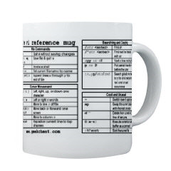
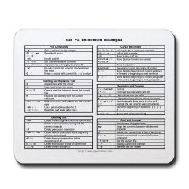
For the vi Lover

Slide 35
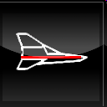
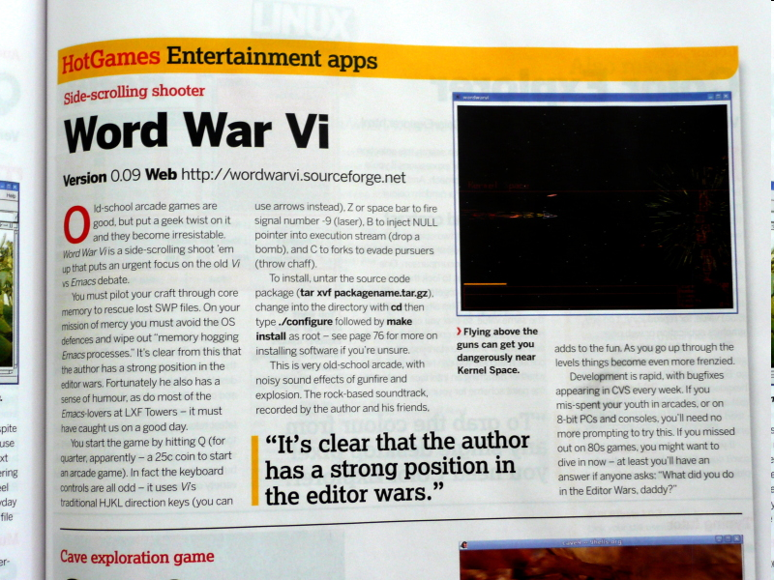
World War VI
http://wordwarvi.sourceforge.net/

Slide 36
World War VI
Word War vi is your basic side-scrolling shoot 'em up '80s style arcade game.
You pilot your "vi“-per craft through core memory, rescuing lost .swp files, avoiding OS defenses, and wiping out those memory hogging emacs processes.
When all the lost .swp files are rescued, head for the socket which will take you to the next node in the cluster.

